Slide 1

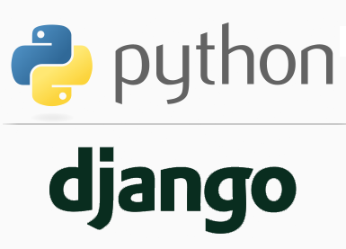
FULL STACK WEB DEVELOPMENT WITH DJANGO
Lecture 37

Slide 2

Today’s Agenda
Developing Our Django App
Developing Session Based Registration/Login System

Slide 3
A Complete Registration-Login-Logout System Using Sessions
Write an app that handles complete registration-login – logout system .
The app should behave as follows:
It should allow the user to register
After registering It should provide a link to login form and ask the user to login .
If login is incorrect then appropriate error message should be displayed on the same login form.
If login is correct the user should be redirected to secret_page.html along with a logout option
When user clicks on logout , he should be logged out and a link should be displayed to go to login page as well as for registration page.

Slide 4
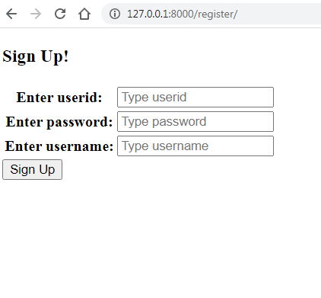
Expected Output

Slide 5
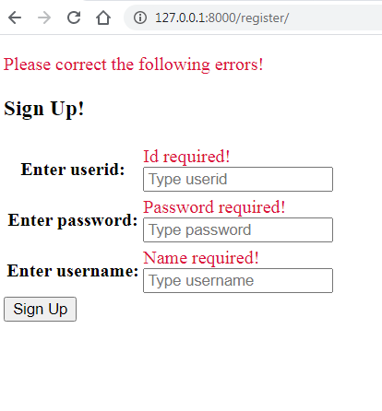
Expected Output

Slide 6
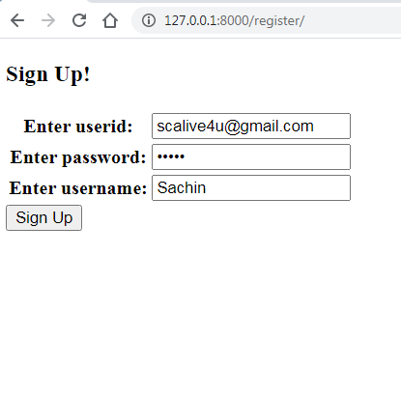
Expected Output

Slide 7
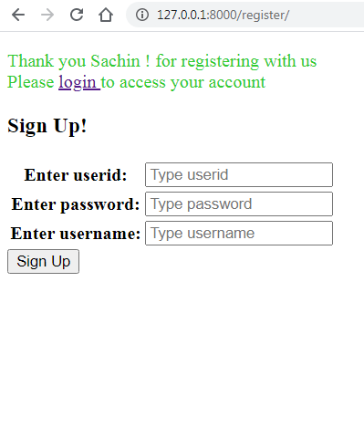
Expected Output

Slide 8
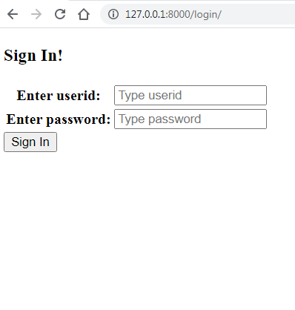
Expected Output

Slide 9
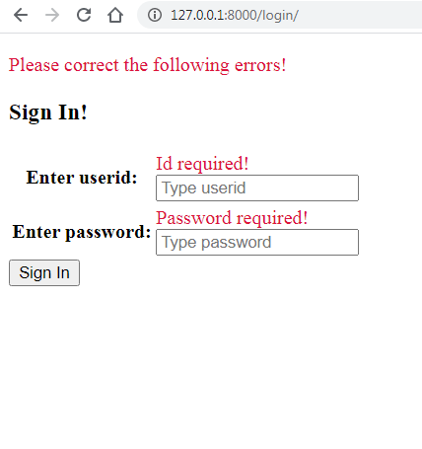
Expected Output

Slide 10
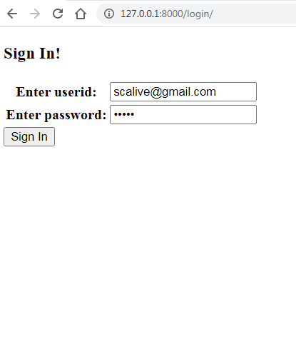
Expected Output

Slide 11
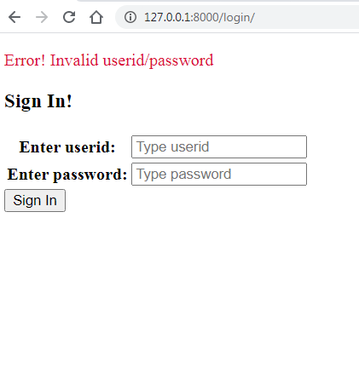
Expected Output

Slide 12
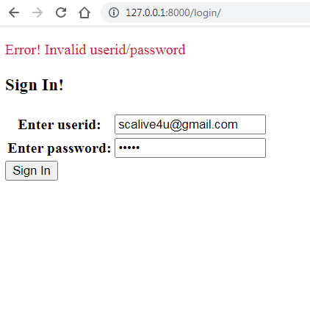
Expected Output

Slide 13
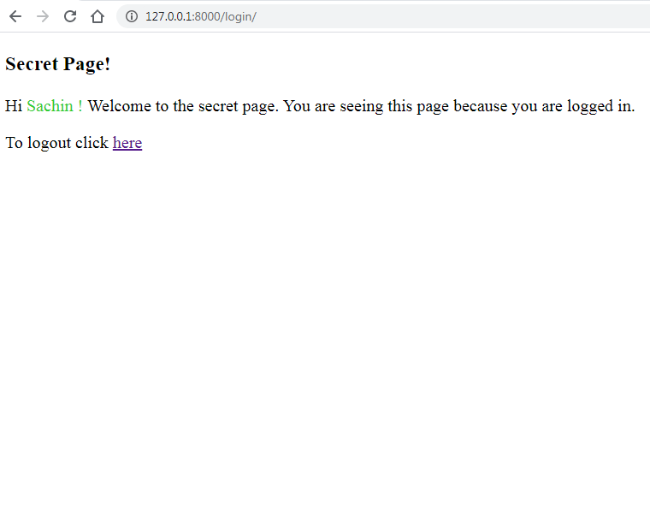
Expected Output

Slide 14
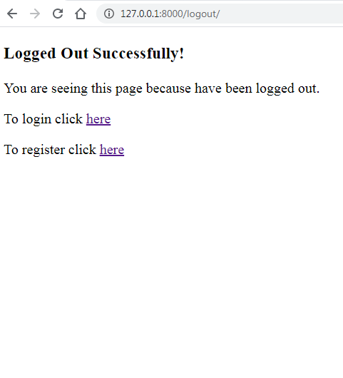
Expected Output

